Slide 1
Evaluation and reflection
August 25, 2022
Hotelschool The Hague
Notes:
m

Slide 2
Agenda for the session
Evaluation of the summer school
Tips and tops on your solutions
Break
Bring it home!
Notes:
30 minutes

Slide 4
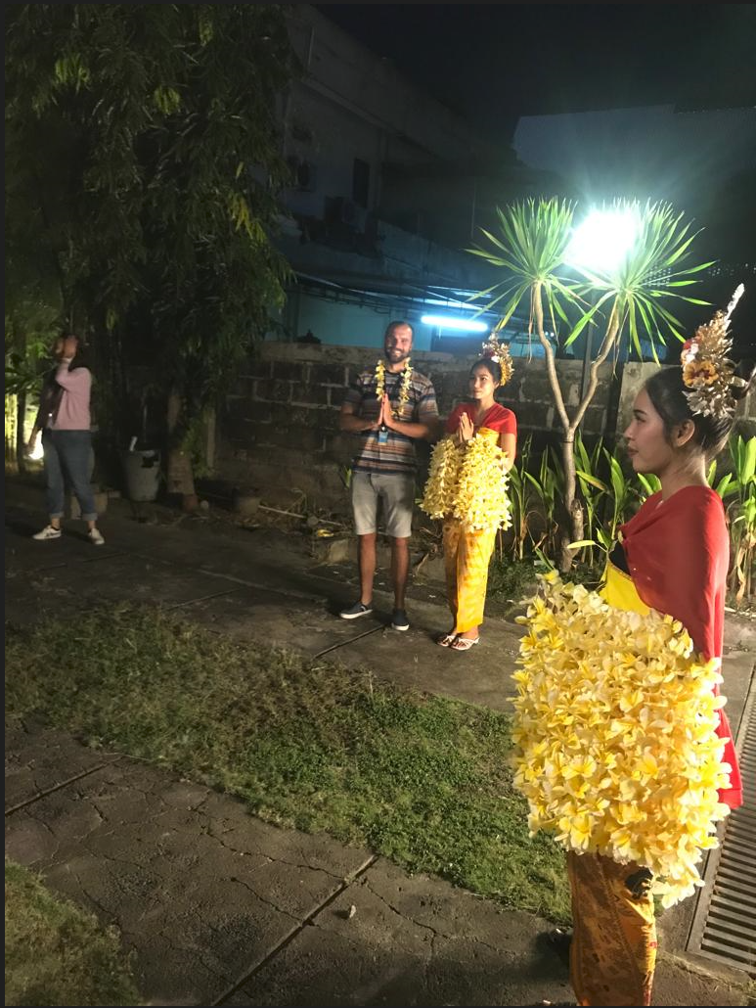

Slide 5
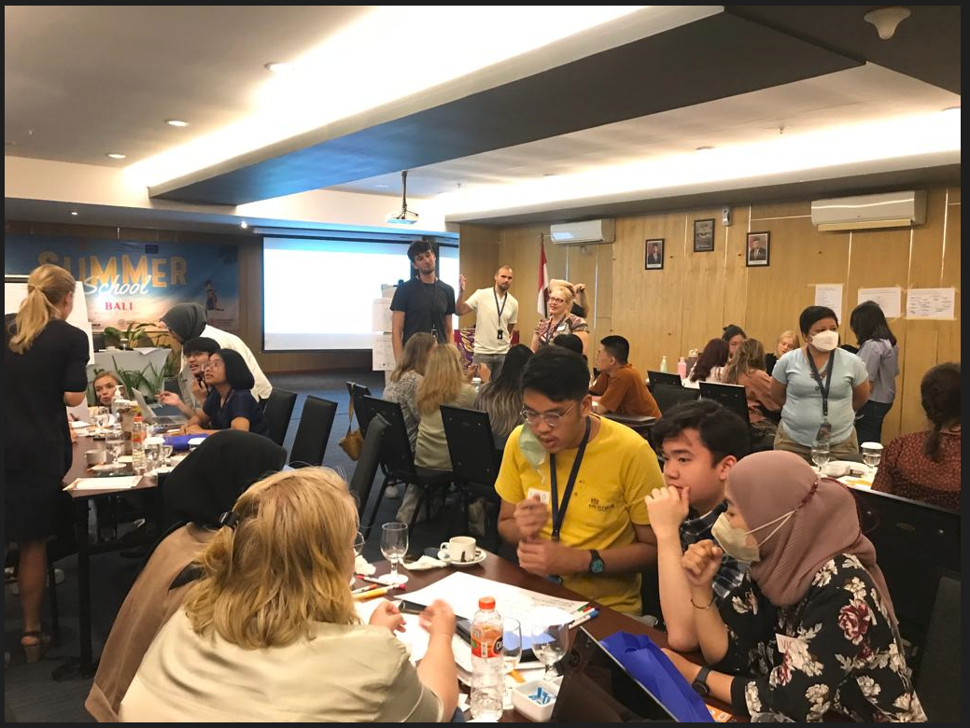

Slide 6
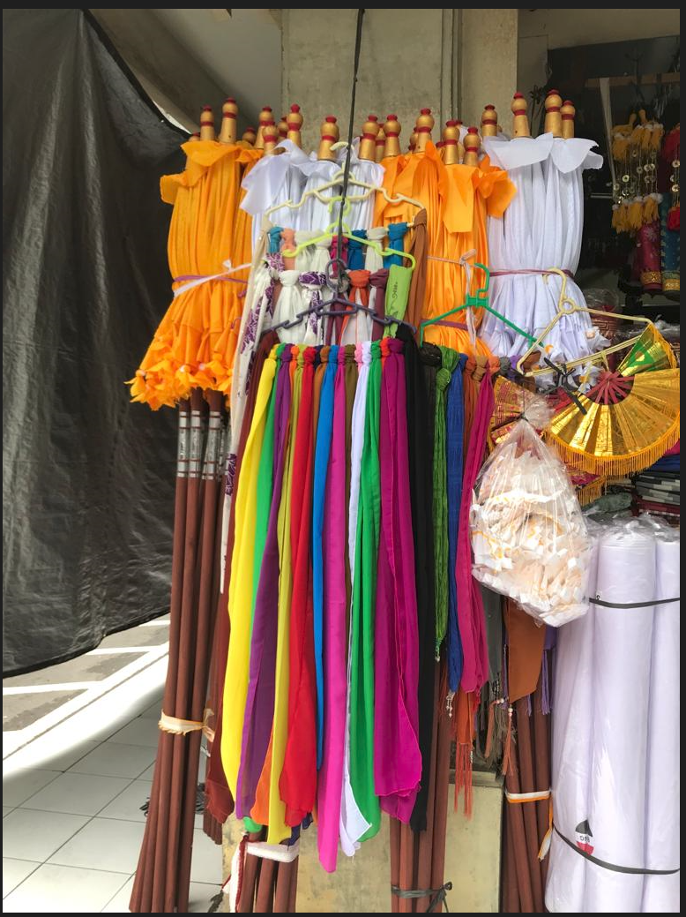

Slide 7
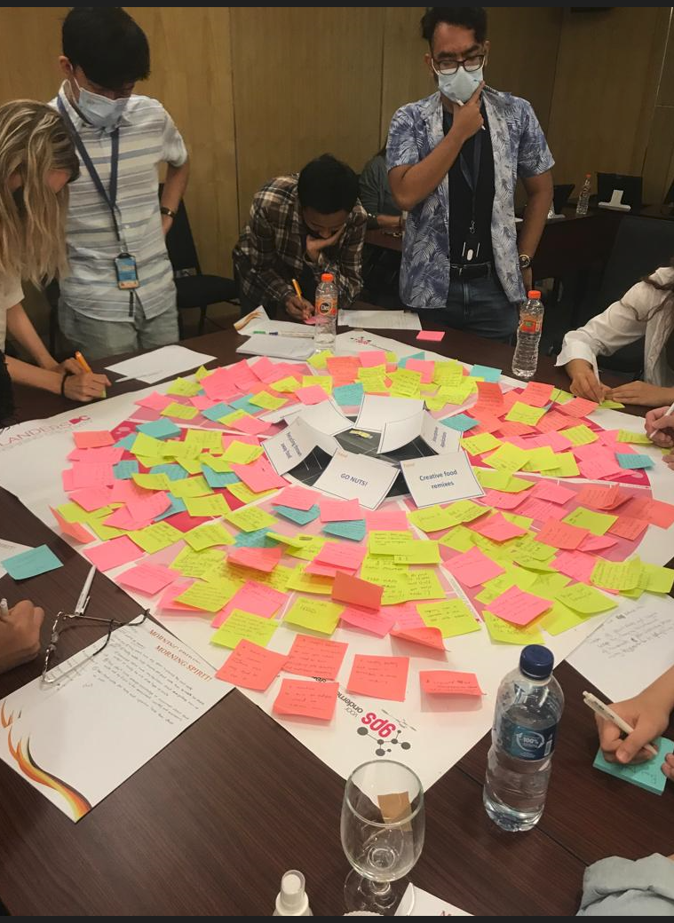

Slide 9
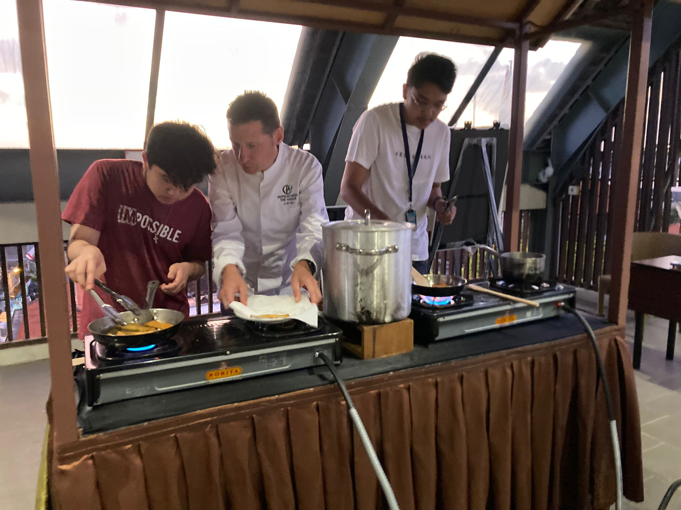

Slide 10
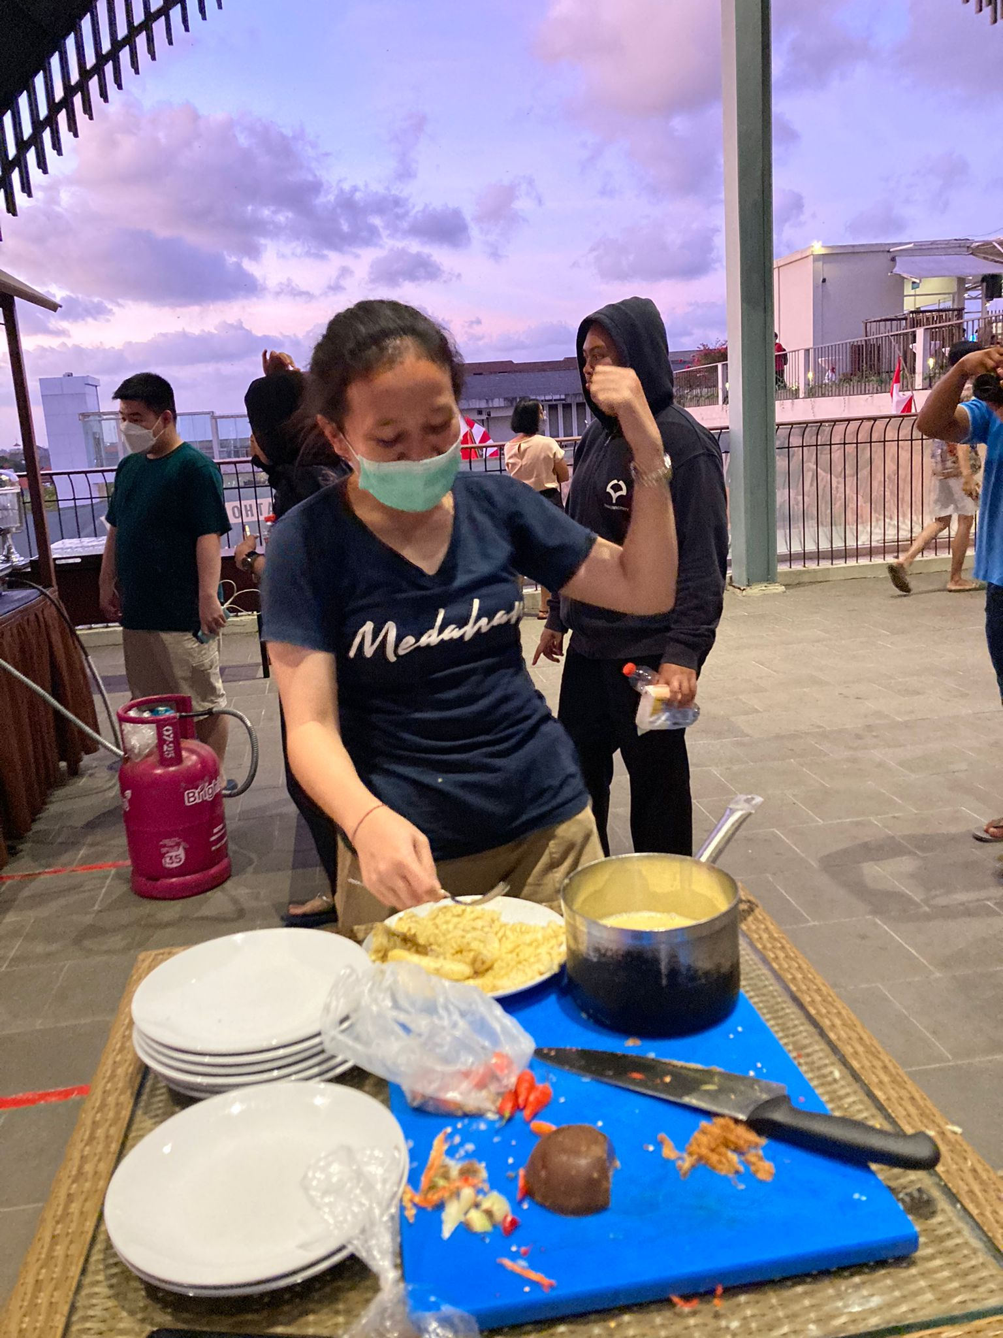

Slide 11
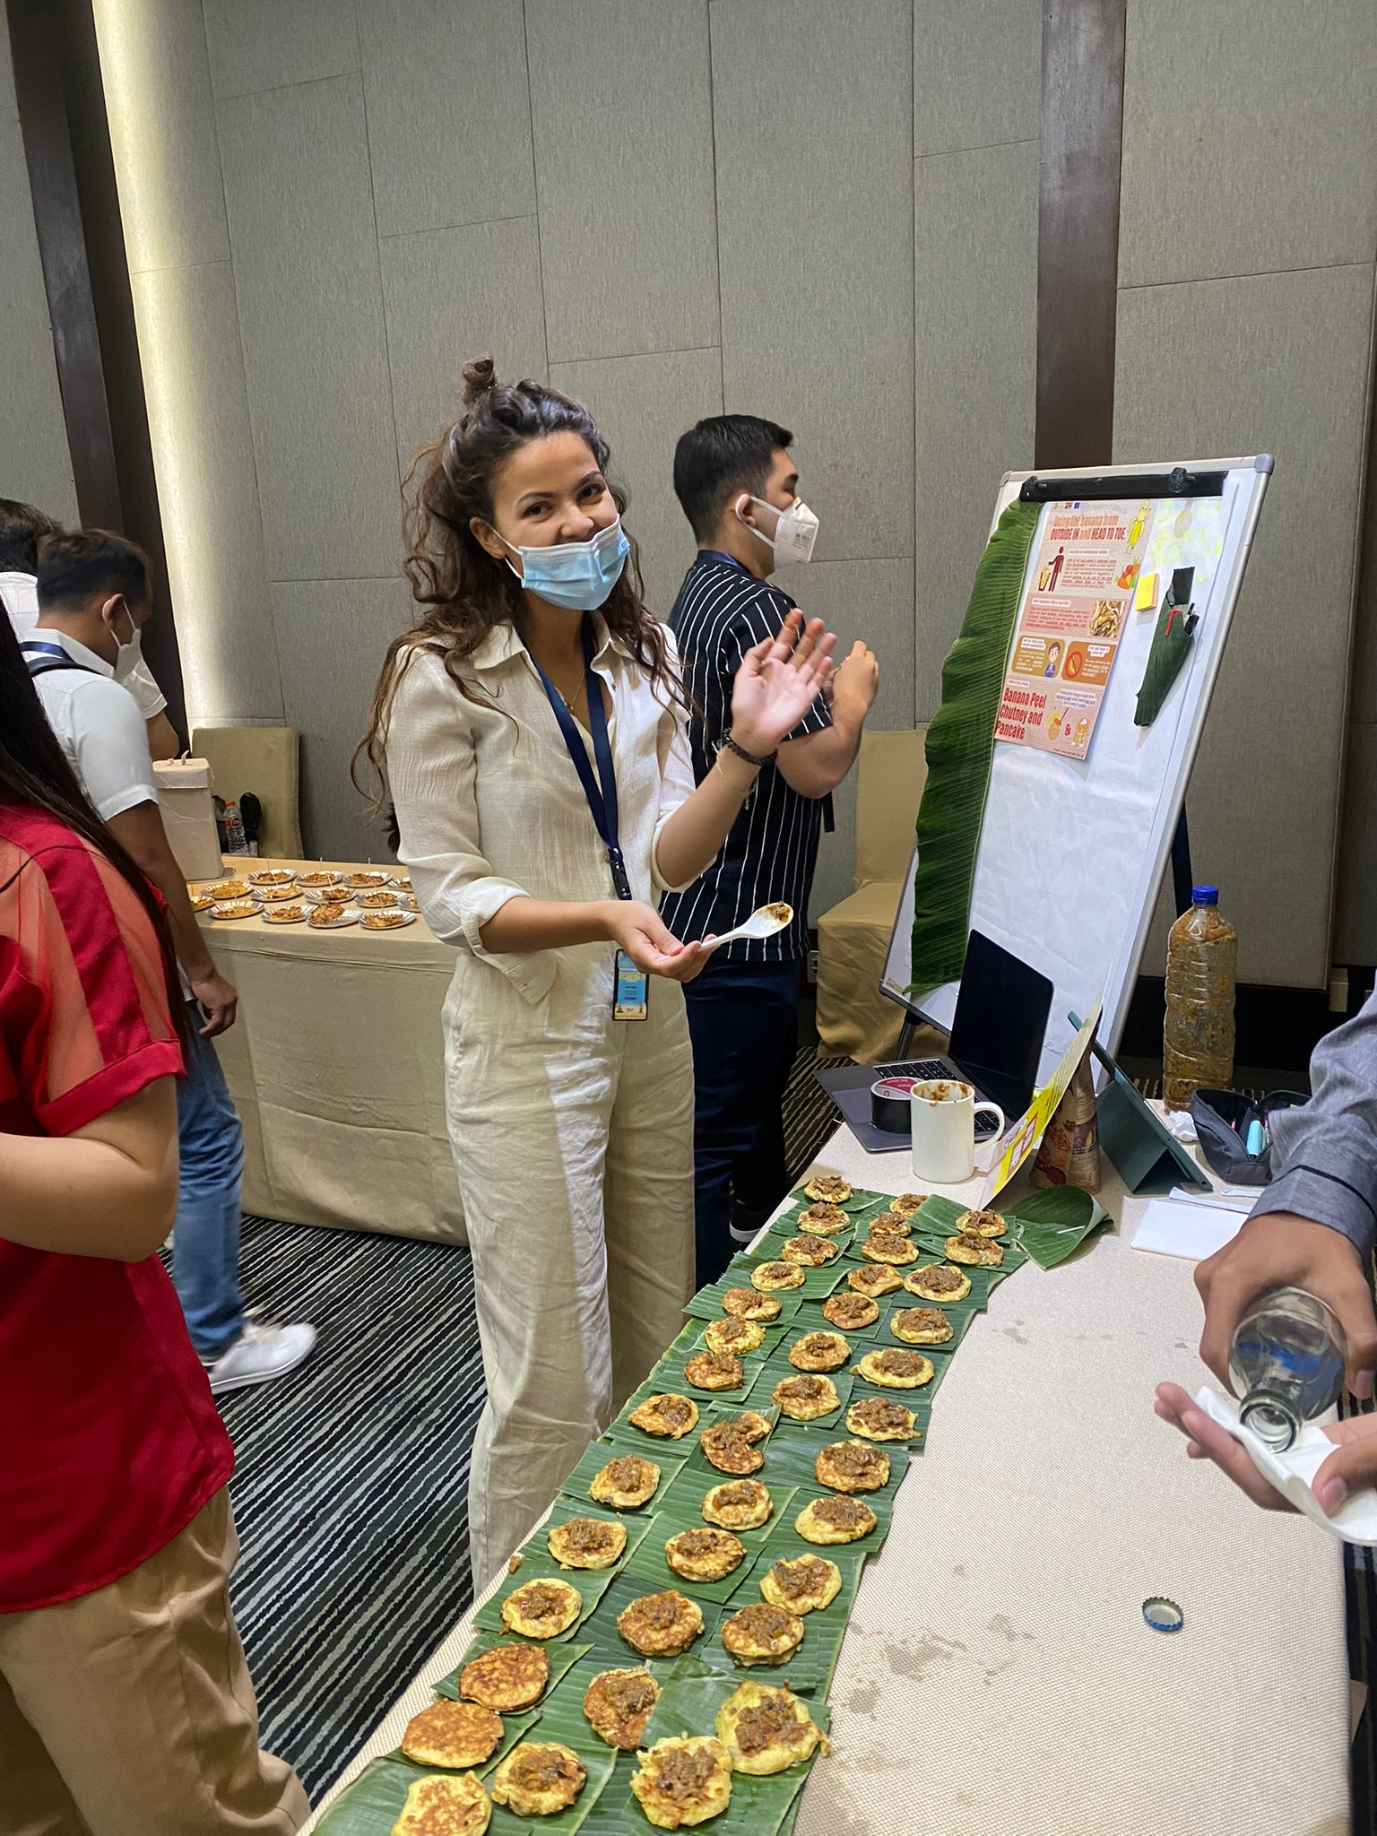

Slide 12
Evaluation summer school
Link to the survey (to distribute via whatsapp group):
https://ghentunipss.eu.qualtrics.com/jfe/form/SV_1Ce5lXkcAVUtoi2
Notes:
30 minutes

Slide 13
Tips and tops on your solutions
Step 1: Teams review the tip and top forms from staff and review tips and tops from fellow students
Step 2: Reflect on the tips and tops individually with help of the following questions:
What did others notice that you did really well as a team?
What is your biggest learning from the summer school?
What is the tip or top you are most proud of that you received?
Which part of the project would you like to find out more about in the next months?
What are the biggest opportunities to make change in the field or food waste?
If given the opportunity, one thing I would change about the solution is….
Write, draw, doodle your reflections on an A4
Step 3: In your team, take 2 minutes per person to share some of your reflections from summer school.

Slide 14
Bring it home!
Once you are back at your universities people will ask you: what was the summer school like? To make an impact
Work on a 30 seconds speech that you can deliver, with the following elements:
The essence of what you did during summer school
What the talent is that you used most during summer school
Explain what you would like to do with the insights from summer school (and on what term)
Notes:
30 minutes

